Slide 1
Secure data hiding in image using steganography
CAPSTONE PROJECT
Presented by; SURAJ SINGH
Student Name : SURAJ SINGH
College Name & Department :
TECHNOCRATS INSTITUTE OF TECHNOLOGY
COMPUTER SCIENCE & ENGINEERING

Slide 2
OUTLINE
Problem Statement
Technology used
Wow factor
End users
Result
Conclusion
Git-hub Link
Future scope

Slide 3
Problem Statement
he problem of secure data hiding in images using steganography involves embedding confidential information within digital images in a way that is imperceptible to human vision and resistant to unauthorized detection or tampering. The challenge lies in ensuring high data security, maintaining image quality, and preventing steganalysis attacks. Effective algorithms must optimize data capacity, robustness, and imperceptibility while ensuring ease of extraction for authorized users. This technique is crucial for secure communication, digital watermarking, and data protection.

Slide 4
–
TECHNOLOGY USED
Programming language:
python
Python librarys
Image Processing Libraries;
Open CV (cv2) – For image manipulation and pre-processing
PIL (Pillow) – For handling image formats and pixel-level modifications
NumPy – For efficient matrix operations and handling image data
Steganography Libraries:;
Stegano – A simple Python library for LSB (Least Significant Bit) steganography
Stepic – A Python library for basic image-based steganography
Cryptosteganography – Combines encryption with steganography for enhanced security
SteganoGAN – A deep learning-based steganography approach using Generative Adversarial Networks (GANs)

Slide 5
WOW FACTORS
Advanced Steganography Techniques:
LSB (Least Significant Bit) Modification – Basic but effective.
DCT-Based Steganography – More secure, using frequency-domain techniques.
Adaptive Steganography – Hides data in complex areas of the image to reduce detectability
.
2. Security Enhancement:
AES Encryption Before Embedding – Encrypting the data before hiding increases security.
Multi-Layer Encryption – Encrypting the image itself along with the hidden message .
Steganalysis Resistance – Ensuring the changes are undetectable by statistical methods.

Slide 6
3 High-Capacity & Lossless Methods:
Hiding Large Data in High-Resolution Images – Balancing invisibility with storage.
Reversible Data Hiding – Image can be restored to the original after extraction.
4.Robust Implementation:
Cross-Platform Application (Python, Java, or Web) – Making it widely accessible.
User-Friendly GUI (Tkinter, PyQt, Web-based UI) – Intuitive interface for users.
Performance Optimization (Parallel Processing, GPU Acceleration) –Faster encoding/decoding.
5. Real-World Applications:
Secure Communications – Covert messaging in government or military.
Watermarking for Copyright Protection – Embedding ownership data in images.
Medical Data Security – Hiding patient records in medical images.

Slide 7
End users-
Government & Intelligence Agencies-– For covert communication, confidential data exchange, and national security
operations.Military & Defense – Securely transmitting classified information without detection.
Cybersecurity Experts & Ethical Hackers – Ensuring secure data storage and transmission, preventing unauthorized access.
Journalists & Whistleblowers – Protecting sensitive sources and confidential information from surveillance or censorship.
Corporate Organizations – Securing proprietary information, financial records, and intellectual property.
Digital Watermarking & Copyright Protection – Embedding invisible ownership marks to prevent piracy.
Medical & Legal Professionals – Protecting patient records, legal documents, and sensitive client information.
Personal Privacy Advocates – Individuals who wish to protect personal data from cyber threats and unauthorized access...
1. Purpose & Use Cases
Secure Communication: Sending hidden messages without detection.
Digital Watermarking: Protecting intellectual property by embedding copyright data.
Medical Data Security: Hiding patient information in medical images.

Slide 8
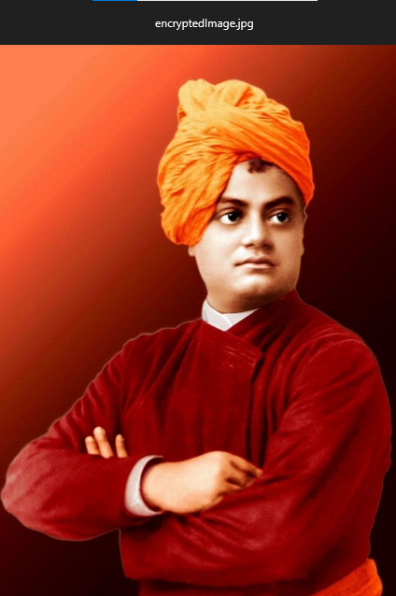
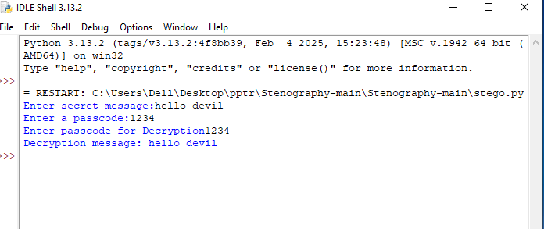
Results outputs:

Slide 9
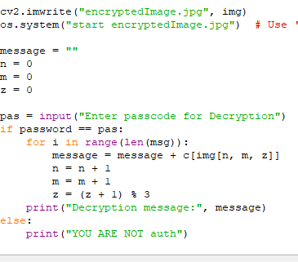
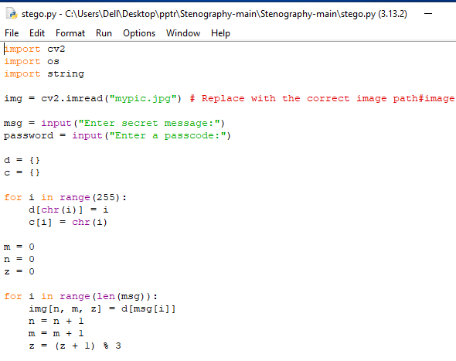
Result inputs:

Slide 10
:
CONCLUSION
This project successfully addresses the problem of secure data hiding by utilizing steganography as a means to conceal information within digital images. The primary goal was to ensure confidential data transmission without drawing attention to the presence of hidden information. By implementing the Least Significant Bit (LSB) substitution method, we achieved a balance between security and image quality, making it difficult for unauthorized users to detect or extract the hidden data.
Our findings demonstrate that steganography is an effective technique for secure communication, especially whencombined with encryption. However, challenges such as vulnerability to steganalysis and capacity limitations highlight the need for further advancements in this field. Future enhancements may include more robust algorithms like Discrete Cosine Transform (DCT) or machine learning-based steganalysis resistance techniques.
Key Outcomes:
Data confidentiality and integrity were successfully maintained without significant image distortion.
The method proved to be efficient, lightweight, and practical for digital communication.
Potential improvements include enhanced security mechanisms and resistance against detection methods.

Slide 11
GitHub Link
https:github.com/suraj-93349/PROJECT-AICTE.git//
https://

Slide 12
FUTURE SCOPE:
Enhanced Security with Cryptography:
Combining steganography with encryption techniques (such as AES or RSA) can add an extra layer of security, making it more difficult for attackers to extract hidden data.
Developing a hybrid cryptography-steganography model for highly secure data transmission.
2. Advanced Steganographic Techniques:
Implementing transform domain methods such as Discrete Cosine Transform (DCT), Discrete Wavelet Transform (DWT), and Singular Value Decomposition (SVD) to make the hidden data more resistant to attacks.
Using adaptive steganography where data embedding dynamically changes based on image properties to avoid detection.
3. Resistance to Steganalysis Attacks:
Developing AI and machine learning-based models to enhance security and make the hidden data more resilient against steganalysis techniques.
Implementing deep learning algorithms to improve detection of unauthorized attempts to retrieve hidden information.

Slide 13
THANK YOU

